Slide 1
Business Opportunity Analysis for Granhub
Business Development Manager
Betsy Xu

Slide 2
Table of contents
01
02
Subscription
Advertising
03
04
E-commerce
Virtual events
Grow subscriber base
Attract more advertising aimed at growing revenue
E-commerce integration helps increase revenue
Organize virtual events to boost revenue

Slide 3
01
Subscription
Increase the subscription rate

Slide 4
Introduction
Increasing the subscription rate for Granhub platform targeting grandparents involves a strategic combination of understanding the target audience, offering valuable content, and enhancing the user experience.

Slide 5
Understand Your Audience
Research and Segmentation:
Demographics: Gather detailed demographic data to understand the age range, interests, and technology comfort level of your target audience.
Personas: Create detailed user personas to tailor your content and marketing efforts.
Feedback Mechanisms:
Surveys and Polls: Conduct surveys to gather insights on user preferences and needs.
Focus Groups: Organize focus groups to dive deeper into the specific desires and pain points of grandparents.

Slide 6
Offer Valuable Content
Relevant and Engaging Content:
Health and Wellness: Provide content related to health, fitness, and mental wellness tailored to older adults.
Hobbies and Interests: Include tutorials, articles, and videos on popular hobbies like gardening, knitting, and genealogy.
Family Connection: Offer tools and resources to help grandparents stay connected with their grandchildren, such as virtual storytelling sessions or tech tutorials.
Exclusive Content:
Premium Articles and Videos: Create exclusive content that is accessible only to subscribers.
Virtual Events: Host subscriber-only webinars, workshops, and virtual social gatherings.

Slide 7
Enhance User Experience
User-Friendly Interface:
Simplified Navigation: Design a straightforward, easy-to-navigate interface with clear instructions.
Accessibility Features: Ensure the platform is accessible, including larger fonts, high-contrast options, and voice-guided navigation.
Personalization:
Customized Recommendations: Use algorithms to recommend content based on user preferences and past interactions.
Personalized Emails and mails: Send personalized newsletters and updates highlighting relevant new content and events.

Slide 8
Effective Marketing Strategies
Targeted Advertising:
Social Media Campaigns: Utilize platforms like Facebook, which have a significant older adult user base, for targeted advertising.
Influencer Partnerships: Collaborate with influencers who are popular among the senior demographic.
Referral Programs:
Incentives: Offer incentives for current users to refer friends and family, such as discounts or free months of subscription.
Easy Sharing: Provide easy-to-use referral tools within the platform.

Slide 9
Offer Free Trials and Discounts
Free Trials:
Limited-Time Access: Provide a free trial period to allow potential subscribers to experience the value of the platform without commitment.
Special Features: Highlight special features and content available during the trial to entice users to subscribe.
Discounts:
Seasonal Promotions: Run seasonal or holiday promotions offering discounted subscription rates.
Bulk Discounts: Offer family or group discounts to encourage multiple subscriptions.

Slide 10
Build Community and Engagement
Interactive Features:
Forums and Groups: Create forums and groups where the elderly people can interact, share experiences, and support each other.
Live Chat and Support: Offer live chat options for immediate support and engagement.
User-Generated Content:
Encourage Sharing: Allow the elderly people to share their own stories, photos, and videos, fostering a sense of community.
Contests and Challenges: Organize contests and challenges to engage users and encourage participation.

Slide 11
Customer Support and Retention
Responsive Support:
Help Centre: Develop a comprehensive help centre with FAQs, tutorials, and troubleshooting guides.
Live Support: Offer responsive customer support through chat, email, and phone.
Retention Strategies:
Regular Updates: Keep subscribers engaged with regular updates, new content, and features.
Feedback Loop: Continuously seek feedback from subscribers to improve the platform and address any issues promptly.

Slide 12
02
Advertising
Attract more advertising aimed at growing revenue

Slide 13
Introduction
Developing a robust e-commerce strategy for Grandhub platform requires understanding audience, offering relevant and high-quality products, and creating a seamless and personalized shopping experience.

Slide 14
Understand the Audience
Demographics and Interests:
Conduct surveys and research to gain insights into the preferences, interests, and behaviours of the target audience – the elderly people.
Understanding what appeals to grandparents can help tailor your advertising strategies.

Slide 15
Content and Engagement
Quality Content:
Create and share content that resonates with grandparents, such as articles on health, hobbies, family activities, and technology tips. Engaging content attracts more users, which can be monetized through ads.
User-Generated Content:
Encourage grandparents to share their stories, photos, and experiences. User-generated content increases engagement and attracts advertisers looking to target a specific demographic.

Slide 16
Targeted Advertising
Data Analytics:
Use data analytics to understand user behaviour and preferences. This data can help create targeted advertising campaigns that are more likely to resonate with your audience.
Personalized Ads:
Implement personalized advertising based on user behaviour and interests. Personalized ads tend to have higher engagement and conversion rates.

Slide 17
Partnerships and Collaborations
Brand Partnerships:
Collaborate with brands that cater to the interests and needs of grandparents, such as health products, travel services, and hobby supplies. These partnerships can include sponsored content, affiliate marketing, and joint promotions.
Influencer Marketing:
Work with influencers who have a strong following among older adults. Influencers can help promote your platform and the products advertised on it.

Slide 18
Monetization Strategies
Ad Networks:
Join ad networks that specialize in targeting older demographics. These networks can help place relevant ads on your platform and increase ad revenue.
Native Advertising:
Use native advertising that blends seamlessly with the platform's content. This type of advertising tends to be less intrusive and more effective.
Subscription Models:
Offer premium subscriptions that provide an ad-free experience or access to exclusive content. This can be an additional revenue stream alongside advertising.

Slide 19
Optimize for Mobile and Desktop
Responsive Design:
Ensure your platform is optimized for both mobile and desktop users. A seamless experience across devices can increase user engagement and ad views.
Ad Placement:
Strategically place ads where they are most likely to be seen without disrupting the user experience. Experiment with different ad formats, such as banner ads, interstitials, and video ads.

Slide 20
Leverage Social Media
Social Media Advertising:
Use social media platforms to promote your content and attract more users. Platforms like Facebook and Instagram offer powerful targeting options to reach older adults.
Community Building:
Build active communities on social media where grandparents can connect and share. A strong social media presence can drive traffic to your platform and increase ad impressions.

Slide 21
Email Marketing
Newsletter Campaigns:
Send regular newsletters with engaging content and advertisements. Segment your email list to provide personalized content that encourages higher engagement rates.
Retargeting:
Use email retargeting to remind users of products or content they viewed on your platform but did not engage with fully.

Slide 22
SEO and SEM
Search Engine Optimization (SEO):
Optimize your platform for search engines to attract organic traffic. Higher traffic can lead to more ad views and higher revenue.
Search Engine Marketing (SEM):
Invest in SEM to drive targeted traffic to your platform. Use paid search ads to reach older adults searching for relevant content and services.

Slide 23
03
E-Commerce
Attract more advertising aimed at growing revenue

Slide 24
Introduction
Increasing advertising to generate revenue for Granhub platform involves a multifaceted approach that leverages the platform's unique demographic and ensures effective targeting and engagement.

Slide 25
Curated Product Selection
Relevant Products:
Offer a curated selection of products that cater to the interests and needs of grandparents. These could include health and wellness products, technology designed for seniors, hobby and craft supplies, travel packages, and family-oriented items.
Partnerships with Brands:
Partner with brands that are popular among older adults to offer exclusive deals and discounts. Ensure these products are of high quality and trustworthy.

Slide 26
Ease of Use
Intuitive Interface:
Design a user-friendly and intuitive e-commerce interface. Ensure the shopping process is simple, with easy navigation, clear product descriptions, and straightforward checkout procedures.
Mobile Optimization:
Ensure your e-commerce platform is fully optimized for mobile devices, as many users may prefer shopping on their phones or tablets.

Slide 27
Content-Driven Commerce
Educational Content:
Provide educational content that helps grandparents make informed purchasing decisions. This could include product reviews, how-to guides, and video tutorials.
Integrated Shopping:
Integrate shopping opportunities within your content. For example, if you publish an article about gardening, include links to purchase gardening tools and supplies directly from your platform.

Slide 28
Customer Support
Responsive Support:
Offer excellent customer support to assist with any issues or questions. Provide multiple channels for support, such as live chat, email, and phone.
Easy Returns:
Implement a hassle-free return policy to build trust and encourage purchases. Clearly communicate return policies to avoid any confusion.

Slide 29
Loyalty Programs and Discounts
Loyalty Programs:
Create loyalty programs that reward repeat customers with discounts, special offers, or points that can be redeemed for future purchases.
Exclusive Discounts:
Offer exclusive discounts and promotions to your members. This can encourage frequent shopping and increase overall sales.

Slide 30
Secure Payment Options
Multiple Payment Methods:
Offer a variety of secure payment options, including credit/debit cards, PayPal, and other popular payment gateways. Ensure the payment process is secure and straightforward.
Subscription Services:
Introduce subscription services for products that grandparents regularly need, such as health supplements or hobby supplies. This can provide a steady revenue stream.

Slide 31
Marketing and Advertising
Targeted Advertising:
Use targeted advertising to promote your e-commerce products. Utilize social media platforms, email marketing, and search engine advertising to reach potential customers.
Seasonal Campaigns:
Run seasonal marketing campaigns to take advantage of holidays and special occasions. Offer themed products and discounts during these times.

Slide 32
Feedback and Improvement
Customer Feedback:
Regularly collect feedback from customers to understand their shopping experience and identify areas for improvement.
Continuous Improvement:
Continuously improve your e-commerce platform based on customer feedback and market trends. Stay updated with the latest e-commerce technologies and best practices.

Slide 33
04
Virtual events
Organize virtual events to boost revenue

Slide 34
Introduction
To greatly increase revenue from virtual events on Granhub platform, focus on understanding the audience, offering diverse and engaging content, ensuring high production quality, implementing effective monetization strategies, and promoting the events through targeted marketing.

Slide 35
Offer Diverse and Relevant Events
Wide Range of Topics:
Health and Wellness: Yoga, meditation, nutrition, and fitness classes.
Technology Tutorials: How to use smartphones, social media, and internet safety.
Hobbies and Crafts: Knitting, painting, gardening, and other creative activities.
Intergenerational Activities: Events that involve grandchildren, such as storytelling, cooking classes, or virtual game nights.

Slide 36
Engaging and Interactive Formats
Interactive Sessions:
Include Q&A sessions, polls, live chats, and breakout rooms to keep participants engaged and involved.
Hands-On Workshops:
Host workshops where participants can actively participate and follow along, such as cooking or craft sessions.
Guest Speakers and Experts:
Invite renowned speakers and experts in relevant fields to lead events, providing valuable insights and attracting more participants.

Slide 37
High-Quality Production
Professional Setup:
Use high-quality cameras, microphones, and lighting to ensure a professional and enjoyable viewing experience.
Reliable Platforms:
Choose user-friendly and reliable platforms for hosting events, ensuring easy access for older adults.

Slide 38
Monetization Strategies
Ticket Sales:
Charge for event attendance. Offer early bird pricing, group discounts, and bundled packages for multiple events.
Subscription Models:
Introduce a subscription service where members pay a monthly or annual fee for access to a set number of events or exclusive content.
Sponsorship and Partnerships:
Partner with brands and companies targeting the senior market. Offer sponsorship opportunities for events in exchange for financial support and brand promotion.
Merchandise and Kits:
Sell related merchandise or event-specific kits (e.g., crafting supplies for a craft workshop) that enhance the participant experience.

Slide 39
Effective Promotion and Marketing
Email Marketing:
Use targeted email campaigns to promote upcoming events. Highlight the benefits and unique features of each event to entice sign-ups.
Social Media Marketing:
Leverage social media platforms to reach a broader audience. Share engaging content, testimonials, and event highlights to attract interest.
Collaborations:
Collaborate with influencers, bloggers, and other online communities that cater to older adults to expand your reach.

Slide 40
User-Friendly Experience
Easy Registration:
Ensure the registration process is straightforward. Provide clear instructions and support for those who might need help.
Tech Support:
Offer technical support to assist participants in accessing and navigating the virtual events.

Slide 41
Community Building
Exclusive Groups:
Create exclusive online groups or forums where event participants can connect, share experiences, and build a sense of community.
Follow-Up Engagement:
Engage with participants after events through follow-up emails, additional resources, and promotions for future events.

Slide 42
Continuous Improvement and Feedback
Post-Event Surveys:
Collect feedback after each event to understand what worked well and what can be improved. Use this information to refine future events.
Stay Innovative:
Keep up with the latest trends in virtual events and continuously innovate to offer fresh and exciting content.

Slide 43
The best time in the world, cooking time!
Mercury
Venus
Mercury is the closest planet to the Sun and the smallest one in the Solar System
Venus has a beautiful name and is the second planet from the Sun

Slide 44
The best memories
Mercury
Venus
Mars
It’s the closest planet to the Sun and the smallest in the Solar System
Venus has a beautiful name and is the second planet from the Sun
Despite being red, Mars is actually a cold place. It’s full of iron oxide dust

Slide 45
The warm smile that always comfort us
Venus
Jupiter
Mars
Saturn
Venus is the second planet from the Sun
It’s the biggest planet in the Solar System
Despite being red, Mars is a cold place
Saturn is a gas giant and has several rings

Slide 46
Why we should take care of them
Mercury
Venus
Mars
Jupiter
Saturn
Neptune
It’s the closest planet to the Sun
Venus is the second planet from the Sun
Mars is actually a very cold place
Jupiter is the biggest planet of them all
It’s composed of hydrogen and helium
It’s the farthest planet from the Sun

Slide 47
Awesome words

Slide 48
—Someone Famous
“This is a quote, words full of wisdom that someone important said and can make the reader get inspired”

Slide 49
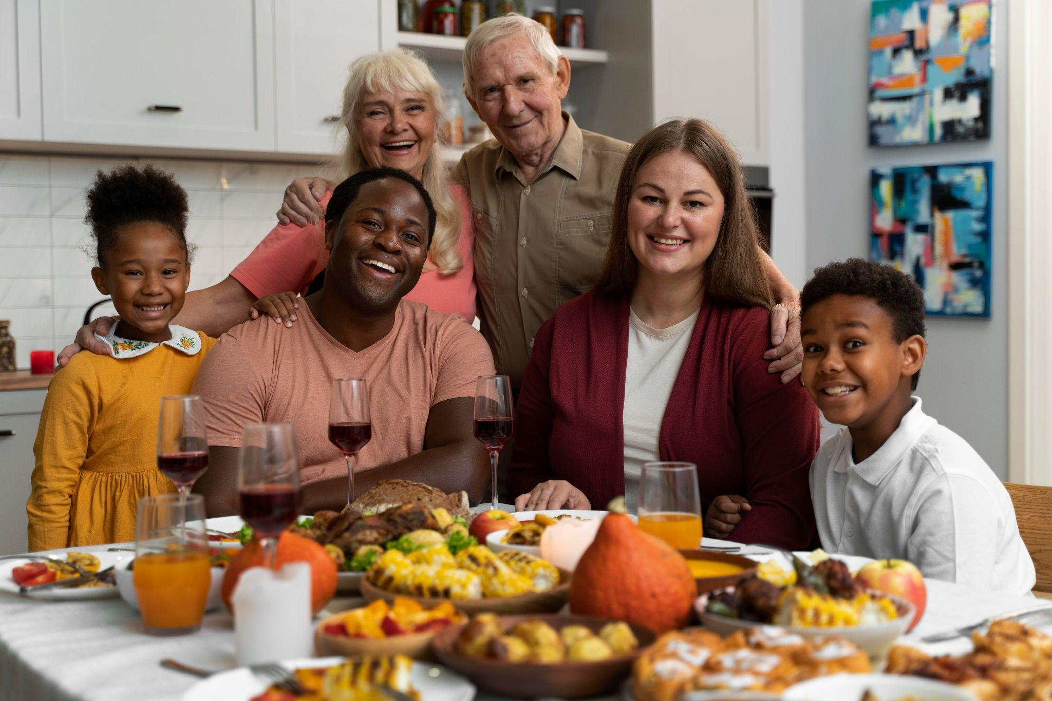
A picture is worth a thousand words

Slide 50

I love spending time with grandpa

Slide 51
1,500
Big numbers catch your audience’s attention

Slide 52
300
650
125
Mercury is the smallest planet
Mars is actually a very cold place
Venus is the second planet from the Sun

Slide 53
Comparison
25%
50%
Mercury
Venus
Mercury is the closest planet to the Sun and the smallest one in the entire Solar System
Venus has a beautiful name and is the second planet from the Sun. It’s a hotter place than Mercury

Slide 54
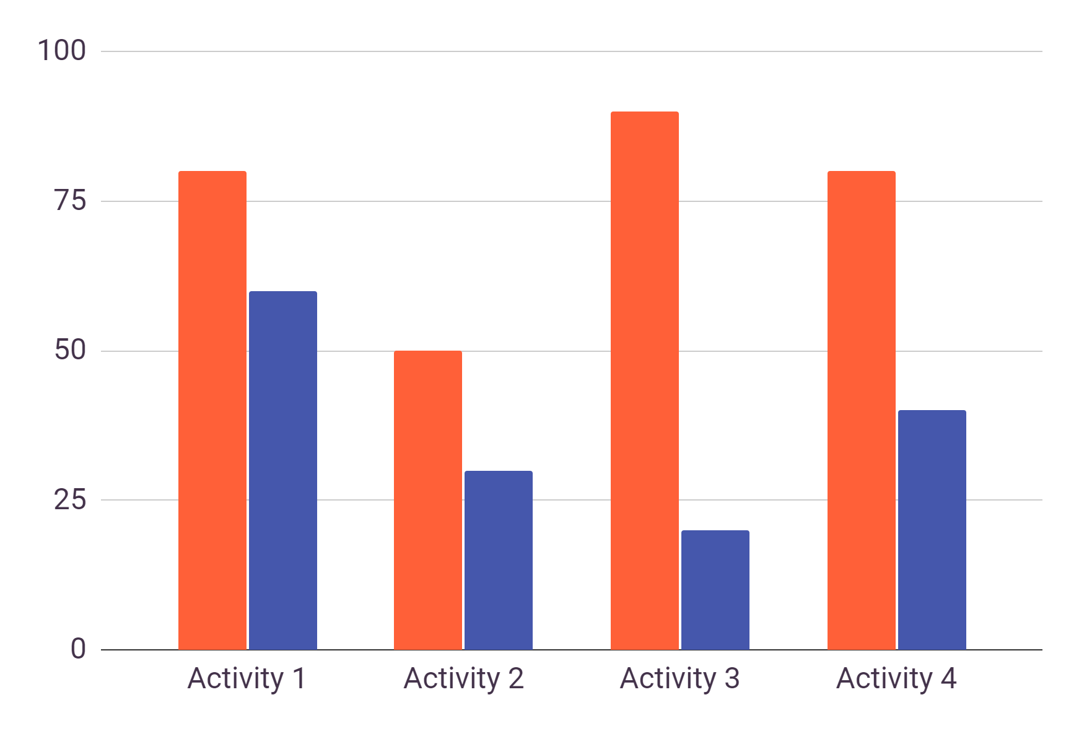
Our favorite activities
Venus
Venus is the second planet from the Sun
Saturn
Saturn is a gas giant and has several rings
Follow the link in the graph to modify its data and then paste the new one here. For more info, click here

Slide 55
Survey results
75%
50%
25%
Venus is the second planet from the Sun
Despite being red, Mars is actually a cold place
Earth is the third planet from the Sun and has life

Slide 56
Grandparents kindness
Neptune
It’s the farthest planet from the Sun
25%
40%
Jupiter
Jupiter is the biggest planet of them all

Slide 57
Use a table!
 | Group 1 | Group 2 | Group 3
Family 1 | 3 | 2 | 5
Family 2 | 6 | 4 | 2
Family 3 | 8 | 2 | 10

Slide 58
02
The story
of getting older together
You can enter a subtitle here if you need it

Slide 59
Where I’ll take my grandparents to
Saturn
Saturn is a gas giant and has rings
Venus
Venus is the second planet from the Sun

Slide 60
Greatest grandpa of all time
2018
2019
2020
2021
Mars
Mercury
Saturn
Venus
Despite being red, Mars is actually a cold place
Mercury is the closest planet to the Sun
Saturn is a gas giant and has several rings
Venus is the second planet from the Sun

Slide 61
Quality times
Mars
Venus
Jupiter
Despite being red, Mars is actually a cold place
Venus is the second planet from the Sun
Jupiter is the biggest planet of them all

Slide 62
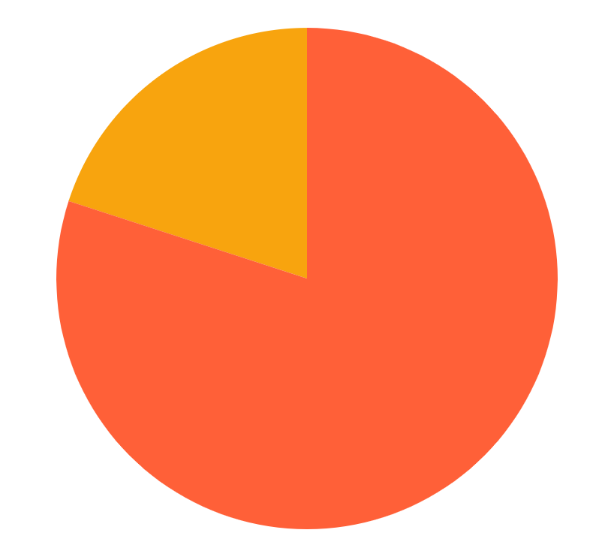
Percentages comparison
20%
Neptune
Neptune is the farthest planet from the Sun
80%
Mercury
Mercury is the closest planet to the Sun
Follow the link in the graph to modify its data and then paste the new one here. For more info, click here

Slide 63
Can’t wait to spend more time with them soon
Mercury is the closest planet to the Sun and the smallest one in the Solar System—it’s only a bit larger than our moon

Slide 64
Unconditional love
Mars
Jupiter
Mercury
Venus
Despite being red, Mars is actually a cold place full of iron oxide dust
Jupiter is a gas giant and the biggest planet in the Solar System
Mercury is the closest planet to the Sun and the smallest of them all
Venus has a beautiful name and is the second planet from the Sun

Slide 65
Family tree
Grandma
Grandpa
Mom
Dad
Me
John
Daisy

Slide 66
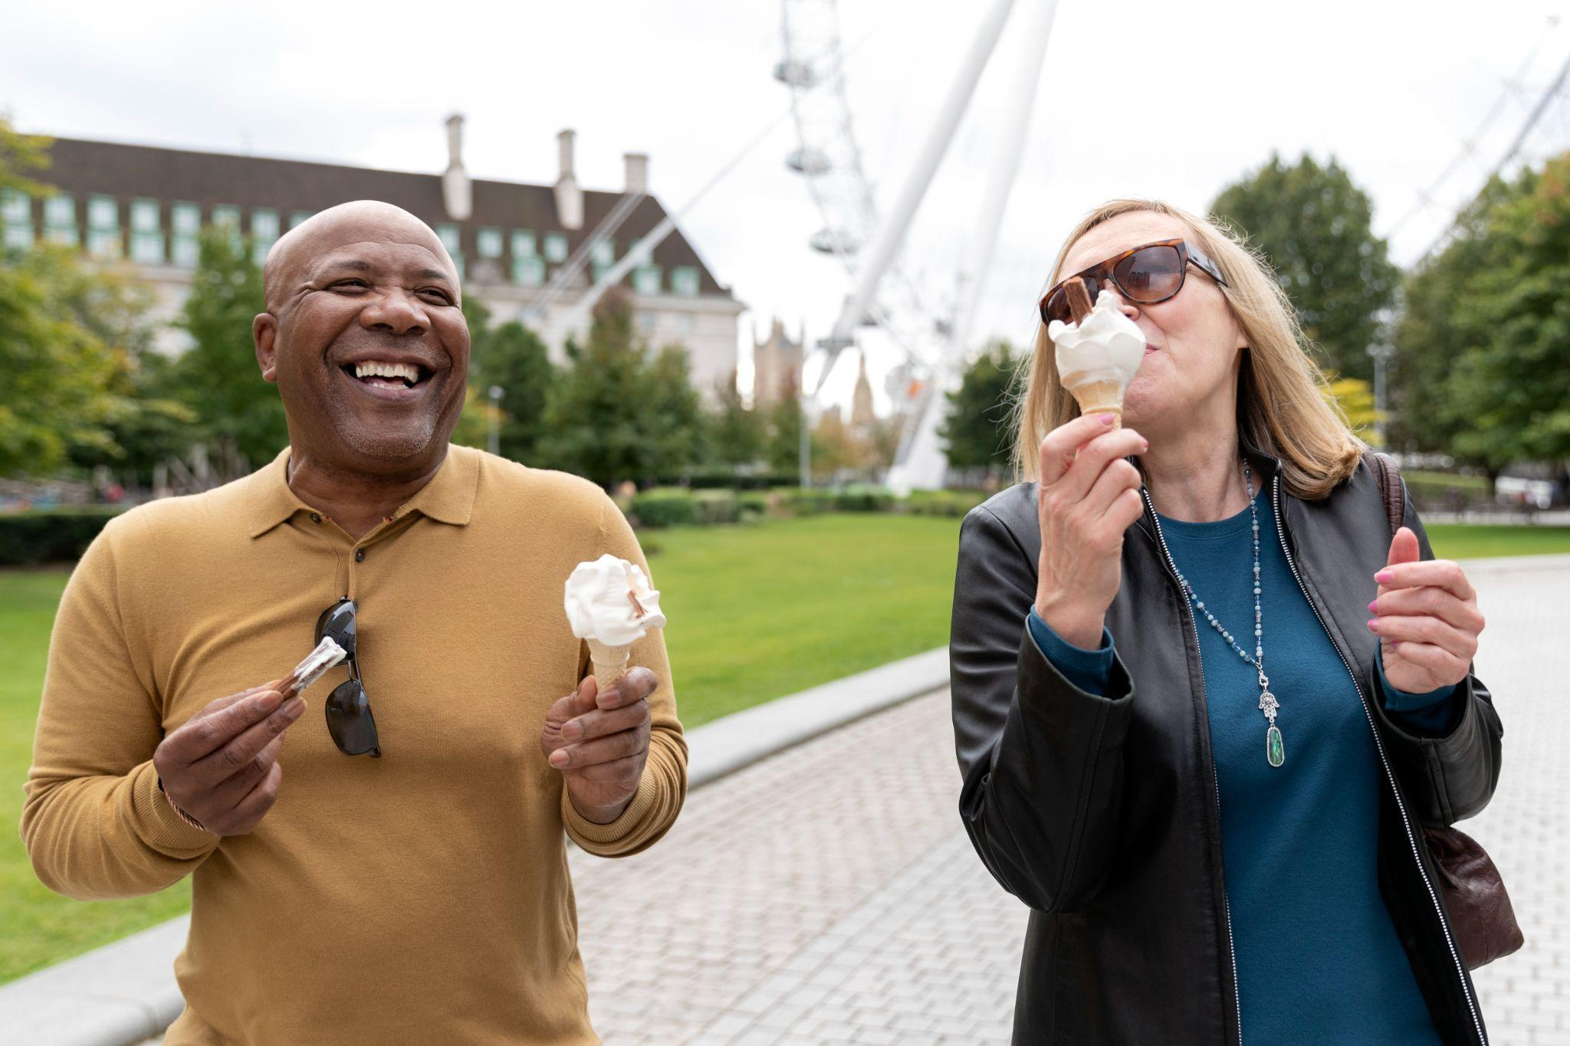
The best grandparents
Grandpa
Grandma
You can speak a bit about this person here
You can speak a bit about this person here

Slide 67
Tablet screenshot
You can replace the image on the screen with your own work. Just right-click on it and select “Replace image”

Slide 68
Desktop screenshot
You can replace the image on the screen with your own work. Just right-click on it and select “Replace image”

Slide 69
Mobile screenshot
You can replace the image on the screen with your own work. Just right-click on it and select “Replace image”

Slide 70
Thank you!
Do you have any questions?
youremail@freepik.com
+91 620 421 838
yourwebsite.com
Please keep this slide for attribution

Slide 71
Alternative resources
Here’s an assortment of alternative resources whose style fits that of this template:
Cartoon dia de los abuelos illustration
Dia dos avos concept in flat design
Older people enjoying a beautiful day

Slide 72
Resources
Did you like the resources on this template? Get them for free at our other websites:
Photos:
Beautiful happy family having a thanksgiving dinner together
Front view young and old friends playing videogame
Medium shot senior people eating ice cream
Vectors:
Flat design dia dos avos concept
Hand drawn national grandparents day illustration I
Hand drawn national grandparents day illustration II
Hand drawn family preparing zongzi
Family enjoying time together
People celebrating their golden wedding anniversary

